Slide 1

Fraud Detection
Group Menbers:
Rajat Mann(C0891806)
Gautam Gulati()
Guneet Singh()
A Fraud detection chatbot by Yaar Beli group.

Slide 2
Today's Presentation
POINTS OF DISCUSSION
Introduction
Problem Statement:
Objectives:
Background/Related Work:
Data Exploration:
Preprocessing:
Model Selection and training
Results
Evaluation/Discussion
Future Work
conclusion

Slide 3
Introduction
Fraud Detection: A Vital Challenge
In the dynamic landscape of financial transactions and digital interactions, the problem of fraud detection has gained paramount importance.
As financial systems and digital services continue to evolve, the need to identify and mitigate fraudulent activities has become a critical concern for businesses, individuals, and institutions alike.
Importance and Significance
The impact of fraudulent activities extends far beyond financial losses, affecting trust, customer satisfaction, and operational efficiency.
Effective fraud detection systems play a pivotal role in safeguarding financial integrity, maintaining customer confidence, and ensuring the smooth operation of various industries.
This presentation explores the complexities of fraud detection and the methodologies employed to tackle this crucial challenge head-on.
Yaar Beli

Slide 4
Problem Statement
Defining the Challenge
The problem at hand revolves around fraud detection in a landscape dominated by imbalanced data.
Our objective is to develop effective strategies and methodologies to identify fraudulent activities within financial transactions and digital interactions.
Dataset: "Fraud Detection using Imbalanced Data"
The dataset titled "Fraud Detection using Imbalanced Data" serves as the foundation of our exploration.
This dataset provides a comprehensive view of real-world scenarios where fraudulent instances are significantly outnumbered by legitimate transactions.
The challenge lies in building models that can accurately detect fraudulent cases while managing the inherent class imbalance.
Yaar Beli

Slide 5
Project Goals
Exploratory Data Analysis (EDA): Conduct a comprehensive exploratory analysis of the "Fraud Detection using Imbalanced Data" dataset to gain insights into its structure, patterns, and potential challenges.
Data Preprocessing: Implement a systematic data preprocessing pipeline to clean, normalize, and transform the dataset, ensuring it's ready for effective model training.
Addressing Imbalance: Utilize Synthetic Minority Over-sampling Technique (SMOTE) to mitigate class imbalance and generate synthetic samples, enabling the models to better capture fraudulent instances.
Machine Learning Models: Train and evaluate a range of machine learning models, selecting the most suitable algorithms for fraud detection that balance precision, recall, and overall performance.
Yaar Beli

Slide 6
Background/Related Work
Understanding the Landscape
Fraud detection has been a critical challenge across industries, including finance, e-commerce, and healthcare.
Traditional approaches often struggle with imbalanced data, where the prevalence of genuine instances outweighs fraudulent ones.
Similar Projects and Approaches
Previous studies have explored methods like Random Forest, Support Vector Machines (SVM), and Logistic Regression for fraud detection.
However, these methods might struggle with imbalanced datasets and fail to capture rare fraudulent instances.
Building Upon Existing Methods
Our project builds upon the foundations of previous work by incorporating Synthetic Minority Over-sampling Technique (SMOTE) to handle imbalanced data.
By using a combination of data preprocessing, feature engineering, and advanced machine learning models, we aim to enhance fraud detection accuracy.
Feel free to customize this slide with specific details, references, or methodologies you've come across in your research.
Yaar Beli

Slide 7
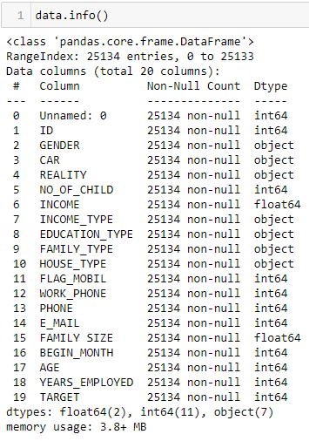
Data Exploration
20 attribuets
25134 rows
Different datatypes
Yaar Beli

Slide 8
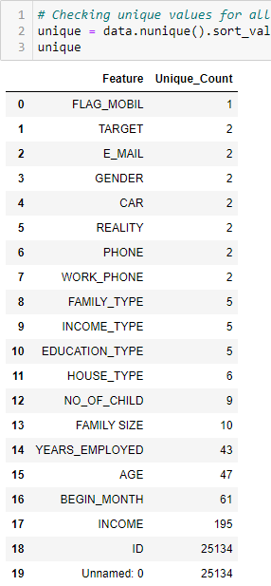
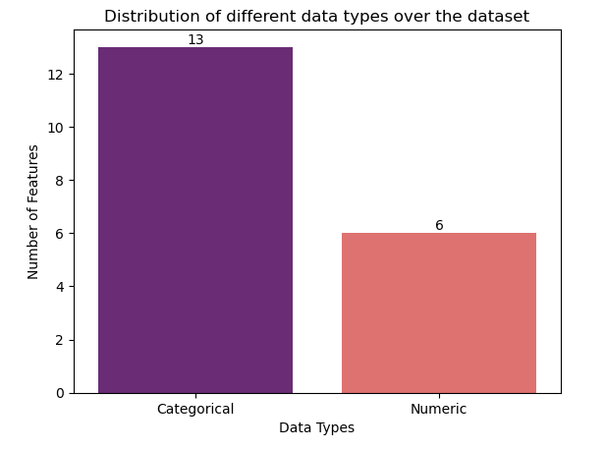
Data Exploration
Yaar Beli

Slide 9
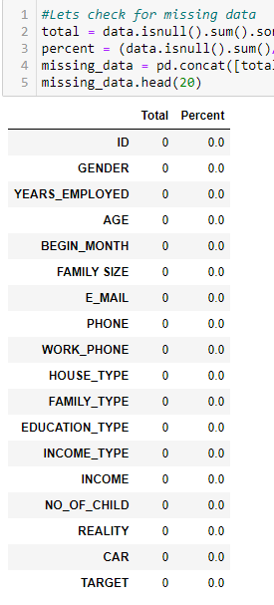
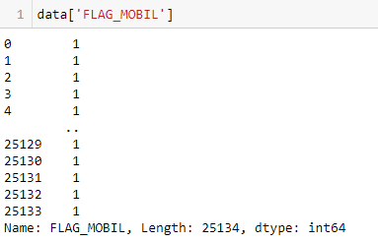
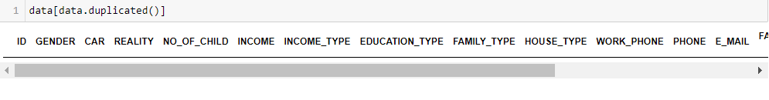
Data Exploration
Yaar Beli

Slide 10
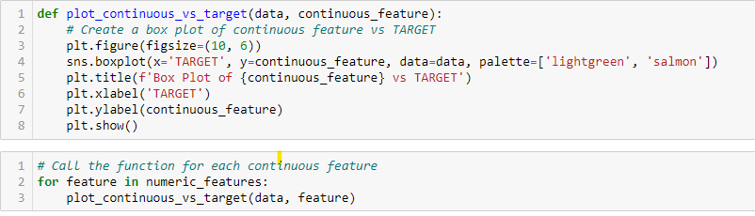
Data Exploration
Yaar Beli

Slide 11
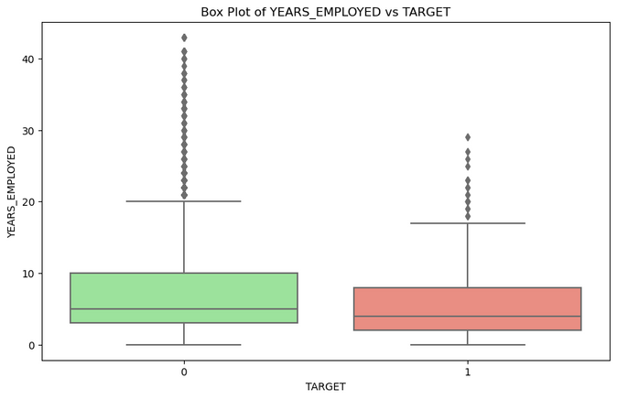
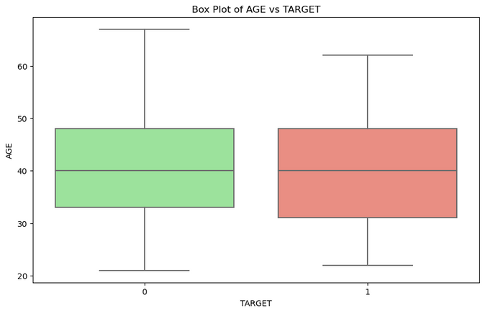
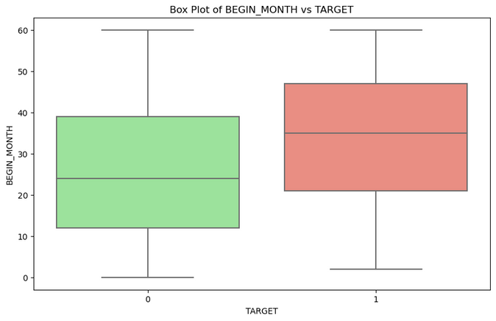
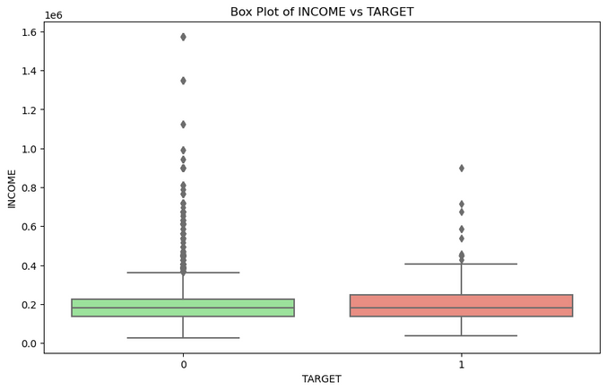
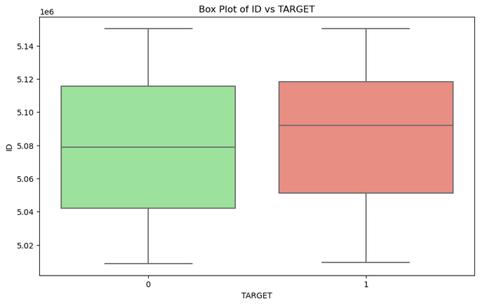
Data Exploration
Yaar Beli

Slide 12
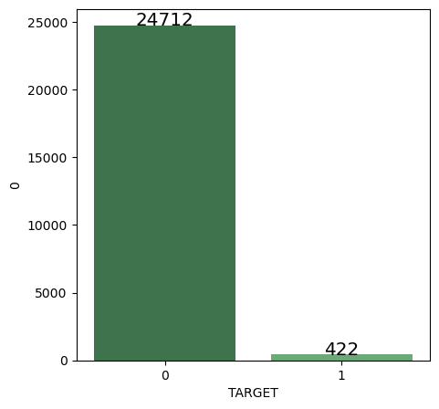
Data Exploration
Yaar Beli
Imabalanced TARGET
SMOTE

Slide 13
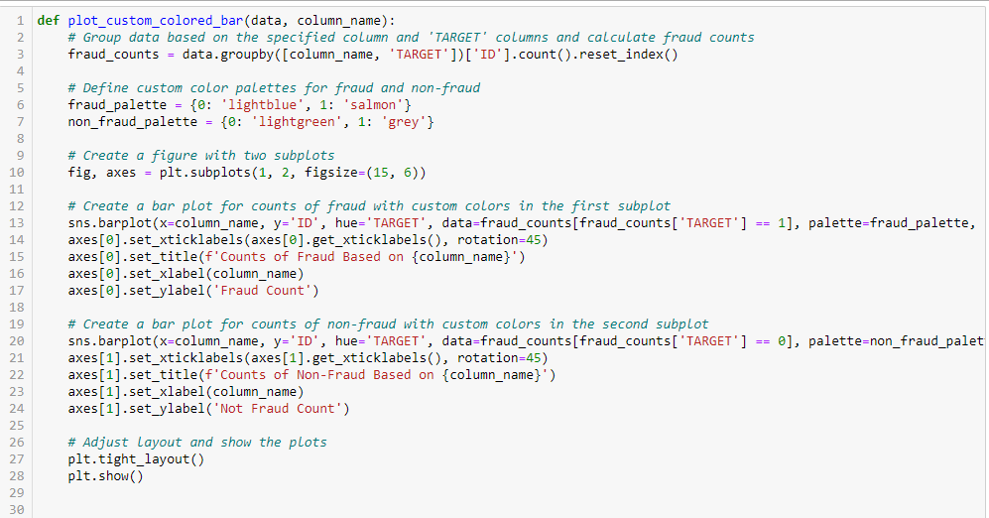
Data Exploration
Yaar Beli

Slide 14
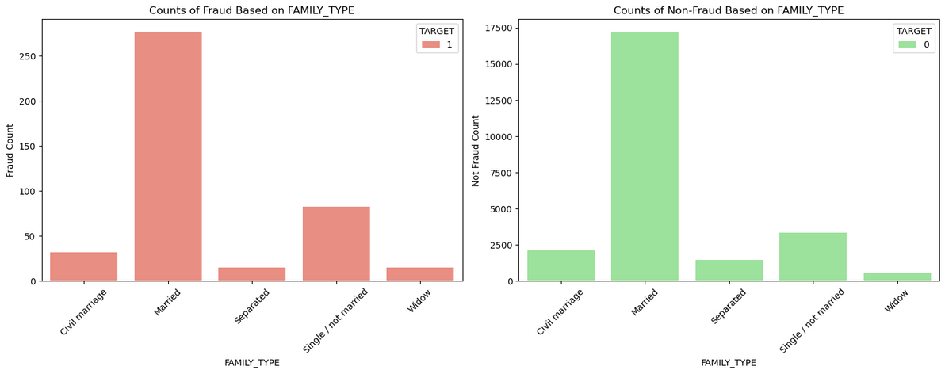
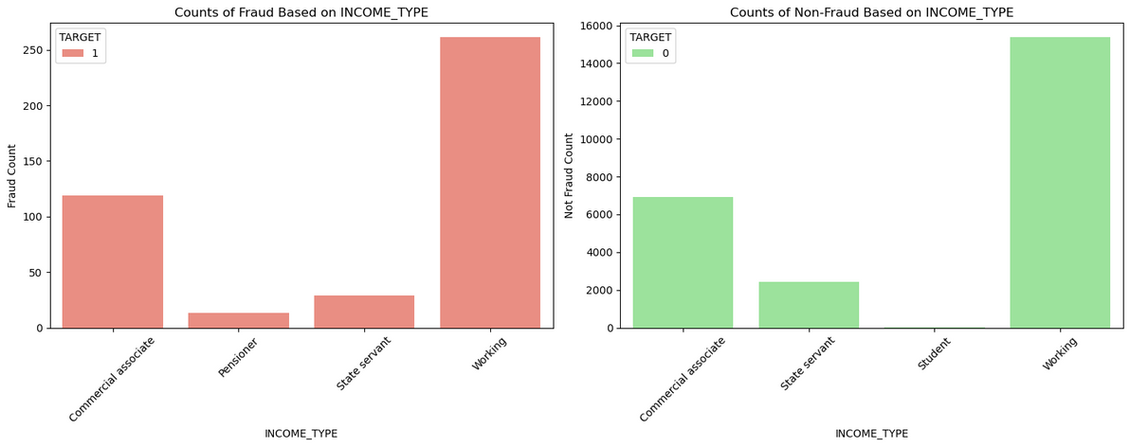
Data Exploration
Yaar Beli

Slide 15
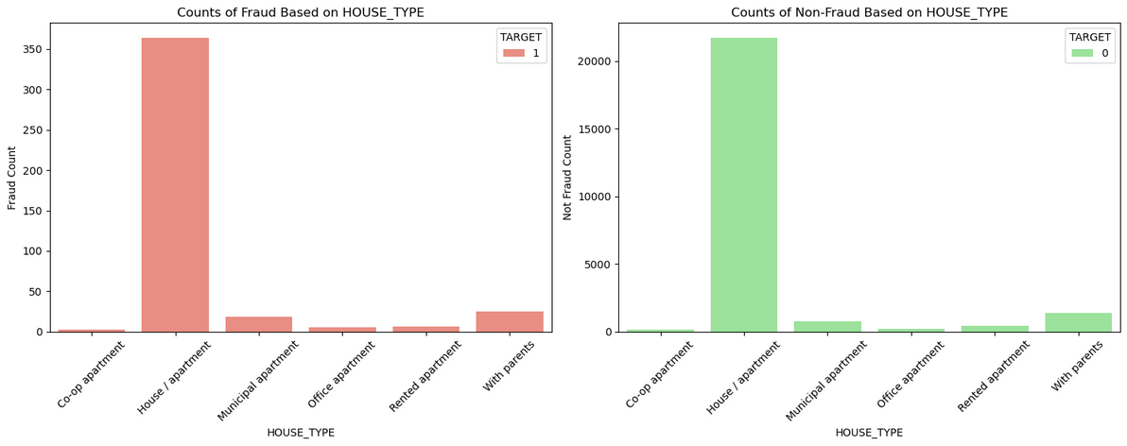
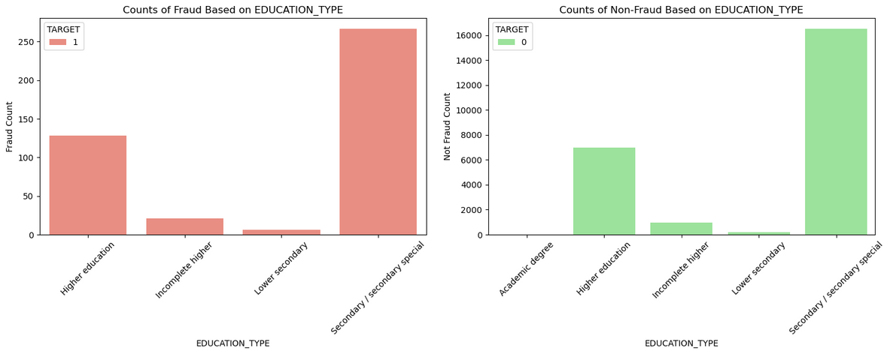
Data Exploration
Yaar Beli

Slide 16
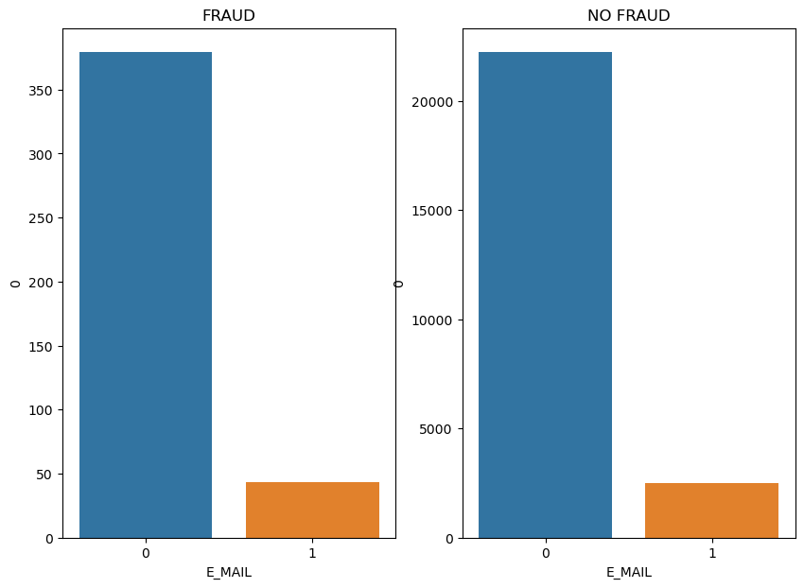
Data Exploration
Yaar Beli

Slide 17
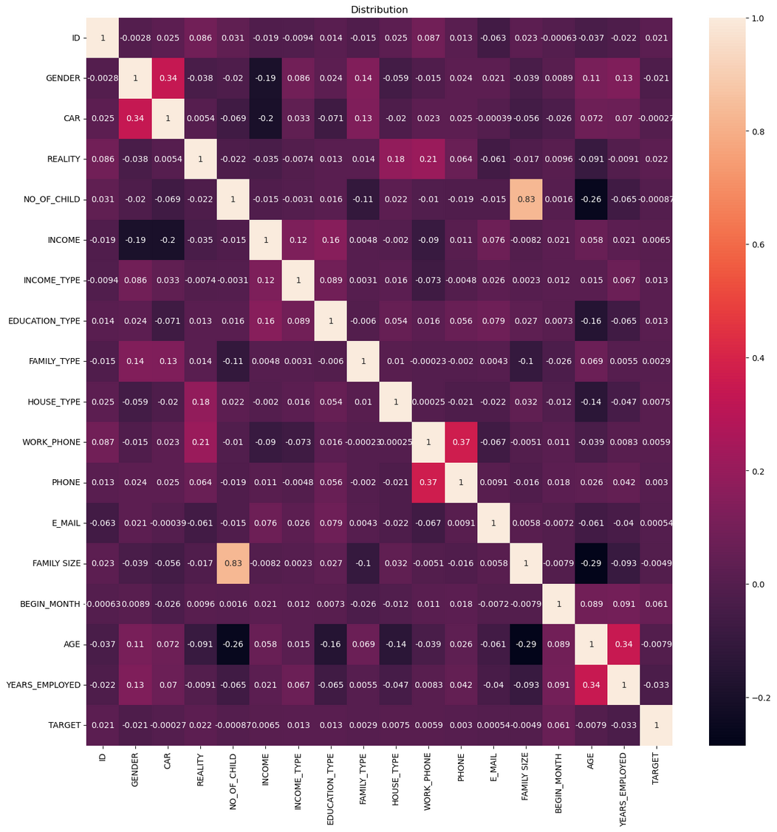
Data Exploration
Yaar Beli

Slide 18
Preprocessing:
Data Cleaning and Feature Engineering
Dropped Columns: We removed the "UnNamed: 0" and "Flag" variables from the dataset, as they were not relevant to our analysis.
Handling Missing Values: Fortunately, the dataset had no missing values, reducing the need for extensive imputation strategies.
Normalization: The absence of the need for normalization simplifies the preprocessing pipeline, allowing us to focus on other tasks.
Encoding Categorical Variables
Feature Encoding: To incorporate categorical variables into our models, we utilized various encoding techniques such as integer Encoding.
Categorical Handling: This approach ensures that categorical data is represented numerically, facilitating model training while preserving the integrity of categorical attributes.
Yaar Beli

Slide 19
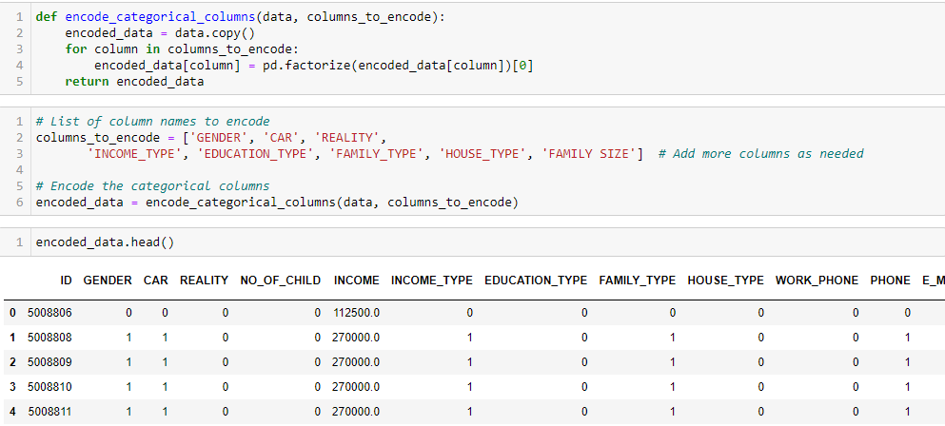
Preprocessing:
Yaar Beli

Slide 20
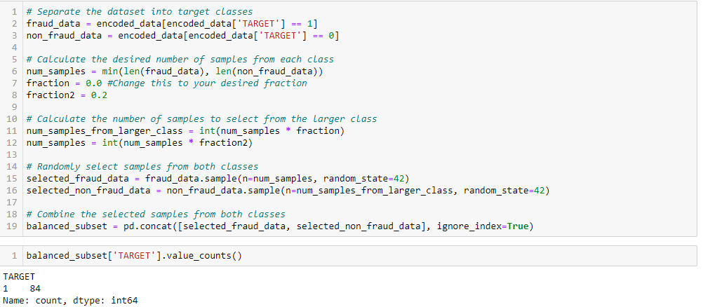
Preprocessing:
Yaar Beli

Slide 21
Model Selection and Training:
Yaar Beli

Slide 22
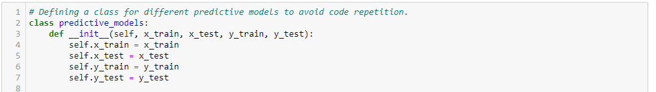
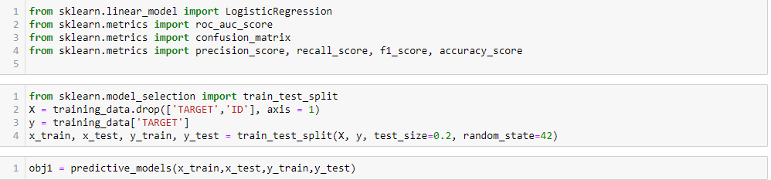
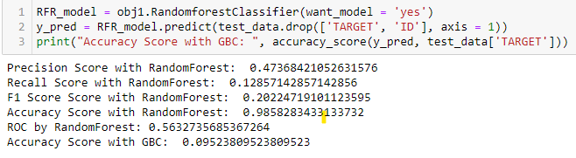
Model Selection and Training:
Yaar Beli

Slide 23
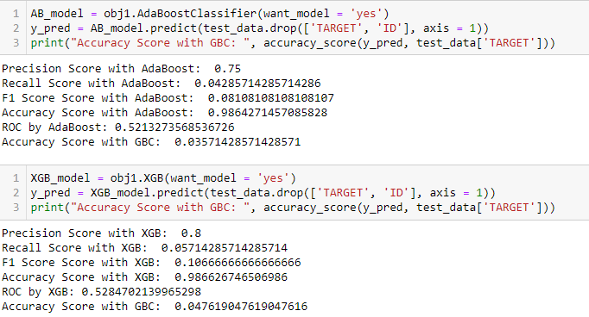
Model Selection and Training:
Yaar Beli

Slide 24
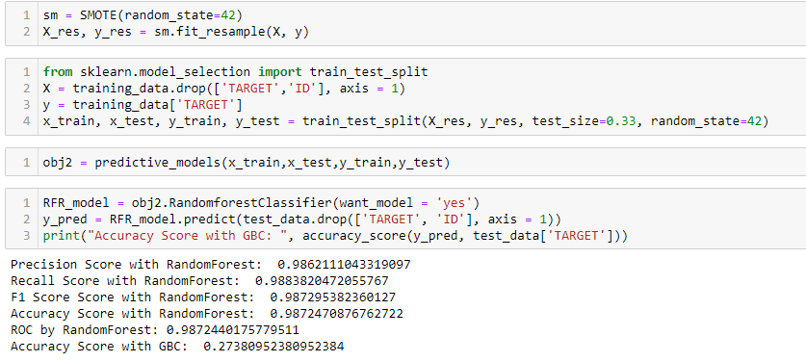
Model Selection and Training:
Yaar Beli

Slide 25
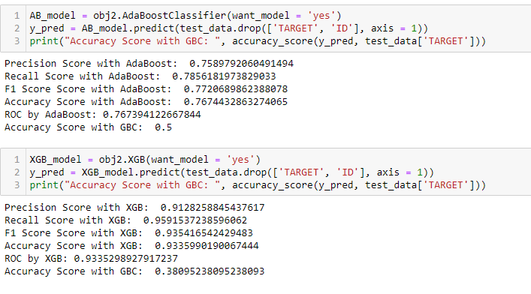
Model Selection and Training:
Yaar Beli

Slide 26
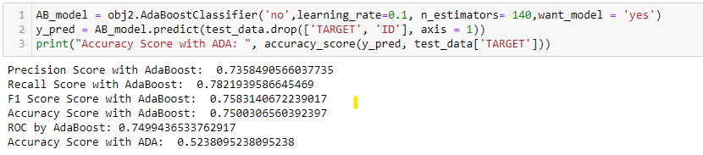
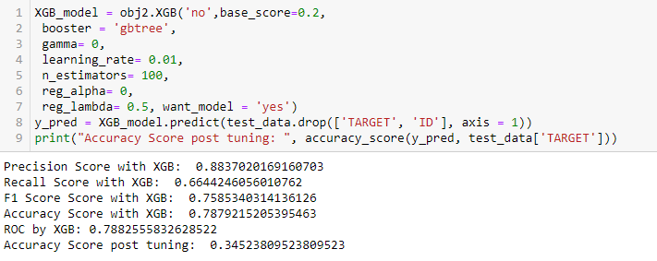
Hyperparameter Tuning
Yaar Beli

Slide 27
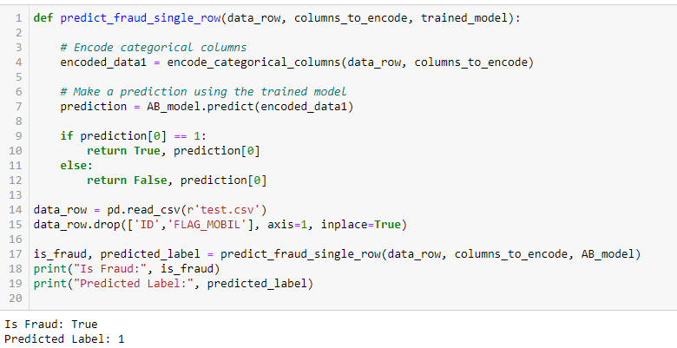
Results
Yaar Beli

Slide 28
Conclusion and Future Work
Addressing Imbalance for Effective Fraud Detection
The journey to enhance fraud detection in imbalanced datasets has been both challenging and enlightening.
Leveraging SMOTE for Balance
The significant class imbalance in our "Fraud Detection using Imbalanced Data" dataset prompted us to leverage Synthetic Minority Over-sampling Technique (SMOTE).
SMOTE's role in generating synthetic samples for the minority class has been instrumental in rebalancing our dataset.
Model Exploration and Refinement
We embarked on a rigorous exploration of machine learning models, including Random Forest Classifier (RFC), AdaBoost Classifier (ADA), and XGBoost Classifier (XGB).
Fine-tuning the models further refined their performance, ensuring our fraud detection system delivers accurate results.
Yaar Beli

Slide 29
Telegram Bot
Yaar Beli

